Slide 1
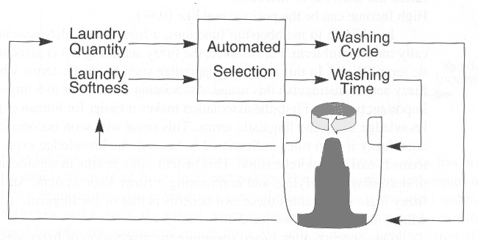
Fully Automatic Washing Machine

Slide 2
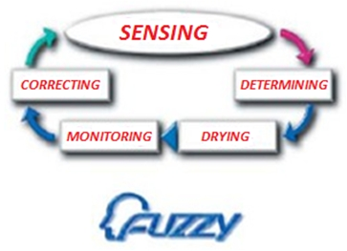
Sensors continually monitor varying conditions inside the machine and accordingly adjust operations for the best wash results.
As there is no standard for fuzzy logic, different machines perform in different manners.

Slide 3
Control the Washing Process
Fuzzy logic controls the washing process,
  water intake
  water temperature
  wash time
  rinse performance
  and spin speed

Slide 4
Automatic WM Functions
More sophisticated machines weigh the load (so you can’t overload the washing machine)
Advise on the required amount of detergent.
Assess cloth material type and water hardness
Check whether the detergent is in powder or liquid form.
Some machines even learn from past experience, memorising programs and adjusting them to minimize running costs.

Slide 5
Automatic WM Feature
Most fuzzy logic machines feature ‘onetouch control.’
Equipped with energy saving features, these consume less power and are worth paying extra for if you wash full loads more then three times a week.
Inbuilt sensors monitor the washing process and make corrections to produce the best washing results.

Slide 6
Automatic WM Feature…..
The fuzzy logic checks for the extent of dirt and grease.
the amount of soap and water to add, direction of spin, and so on.
The machine rebalances washing load to ensure correct spinning.
Else, it reduces spinning speed if an imbalance is detected. Even distribution of washing load reduces spinning noise.
Neuro fuzzy logic incorporates optical sensors to sense the dirt in water and a fabric sensor to detect the type of fabric and accordingly adjust wash cycle.

Slide 7
Example: Fully Automatic Washing Machine
Inputs
  Laundry Softness
  Laundry Quantity
Outputs
  Washing Cycle
  Washing Time
* Fuzzy Logic: Intelligence, control, and Information, J. Yen and R. Langari, Prentice Hall

Slide 8
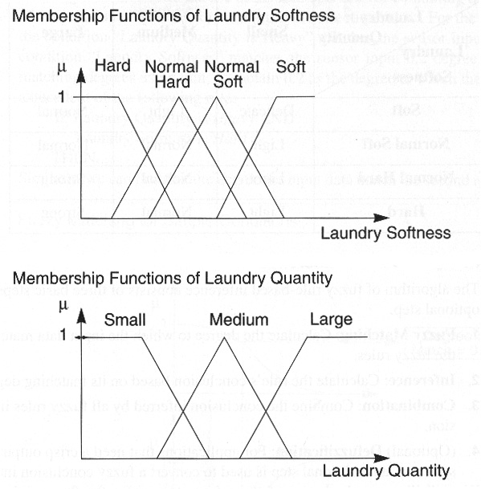
Example: Input Membership functions
* Fuzzy Logic: Intelligence, control, and Information, J. Yen and R. Langari, Prentice Hall

Slide 9
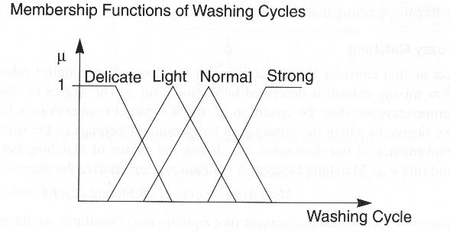
Example: Output Membership functions
* Fuzzy Logic: Intelligence, control, and Information, J. Yen and R. Langari, Prentice Hall

Slide 10
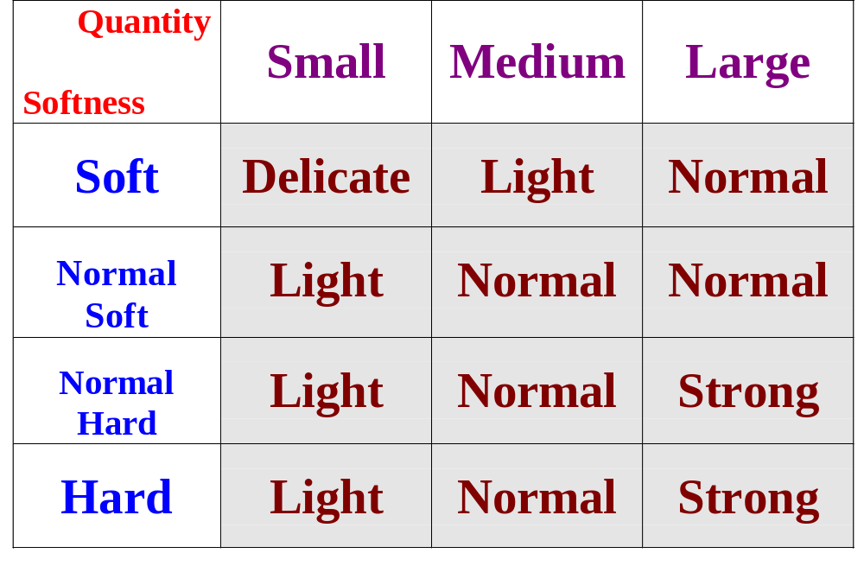
Example: Fuzzy Rules for Washing Cycle
* Fuzzy Logic: Intelligence, control, and Information, J. Yen and R. Langari, Prentice Hall

Slide 11
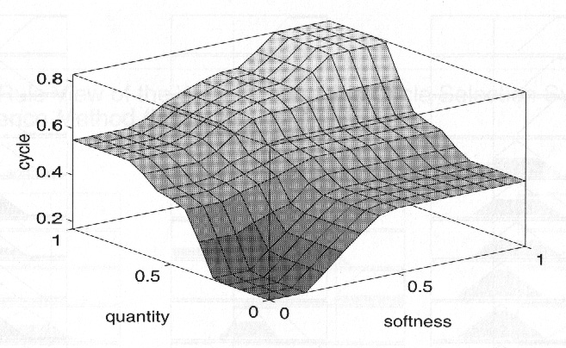
Example: Control Surface View (Clipping)
* Fuzzy Logic: Intelligence, control, and Information, J. Yen and R. Langari, Prentice Hall

Slide 12
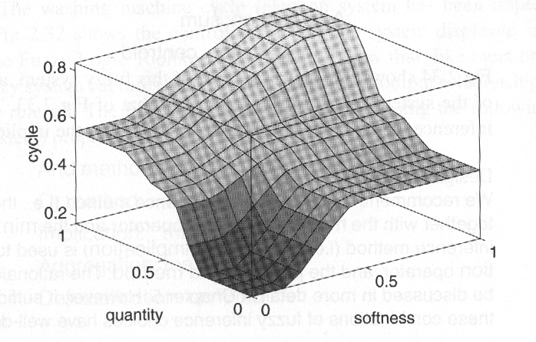
Example: Control Surface View (Scaling)
* Fuzzy Logic: Intelligence, control, and Information, J. Yen and R. Langari, Prentice Hall

Slide 13
Example: Control Surface View
Clipping
Scaling
* Fuzzy Logic: Intelligence, control, and Information, J. Yen and R. Langari, Prentice Hall

Slide 14
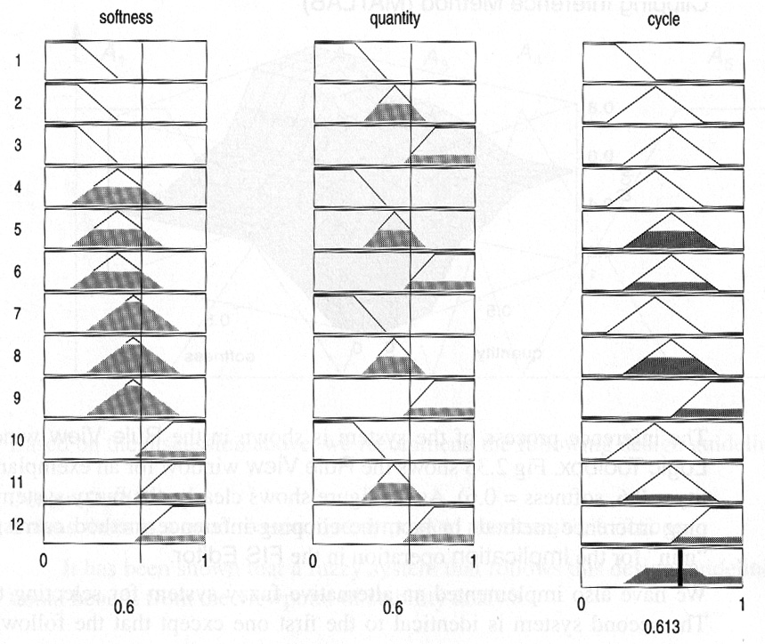
Example: Rule View (Clipping)
* Fuzzy Logic: Intelligence, control, and Information, J. Yen and R. Langari, Prentice Hall

Slide 15
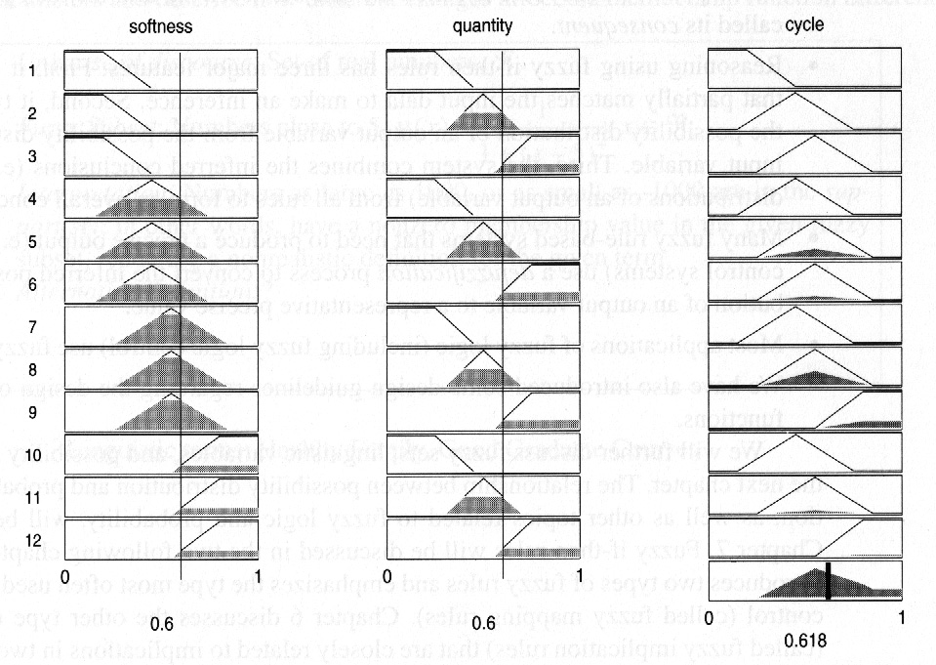
Example: Rule View (Scaling)
* Fuzzy Logic: Intelligence, control, and Information, J. Yen and R. Langari, Prentice Hall

